Slide 1
React
Events - Hooks
useState, useEffect, useRef
Mahhek Tahir
Notes:
.

Slide 2
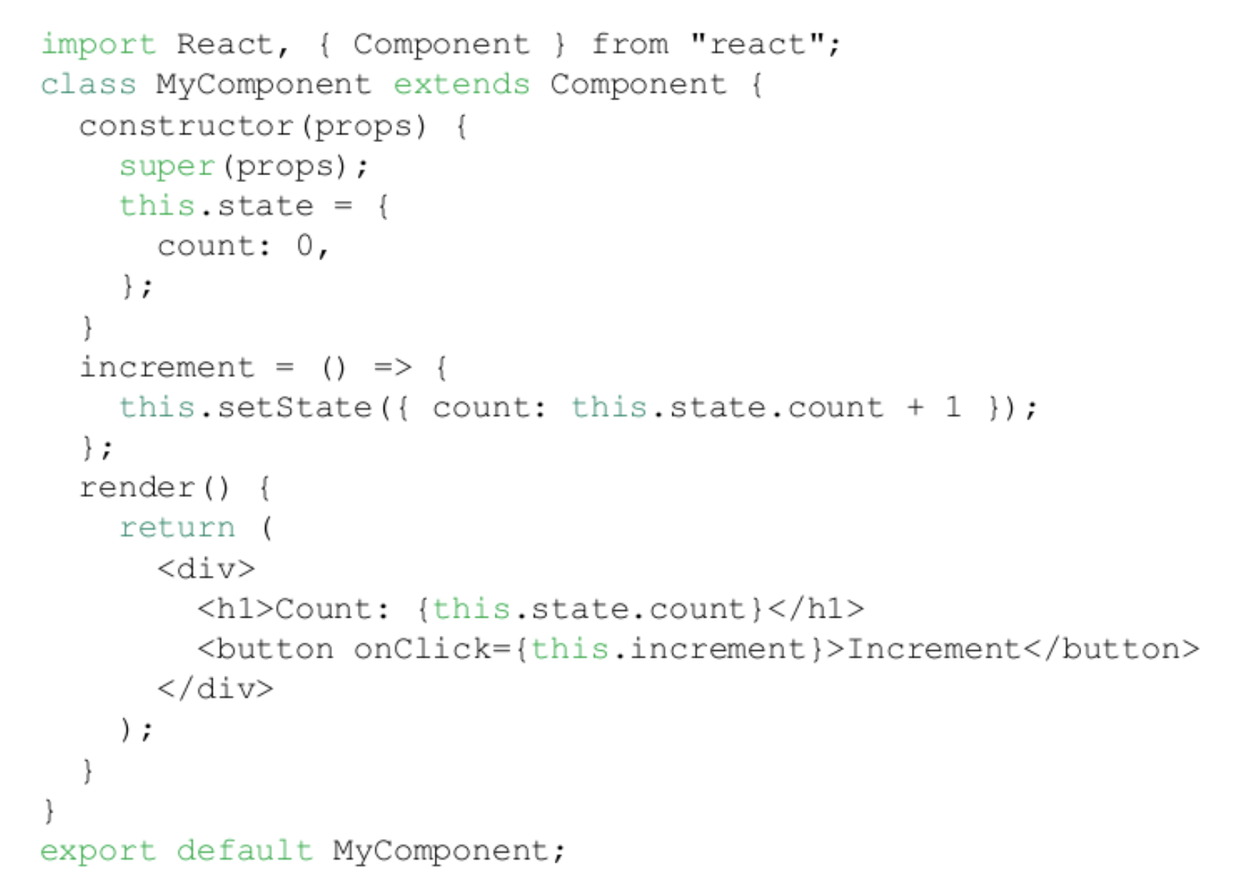
Class Component

Slide 3
Class Components - Life Cycle
Three main lifecycle phases: Mounting, Updating, Unmounting
Mounting (When the component is created and inserted into the DOM)
constructor(): Initializes state and binds event handlers.
render(): Renders the UI.
componentDidMount(): Runs after the component is added to the DOM (used for API calls, subscriptions, etc.).

Slide 4
Updating (When props or state change)
Unmounting (When the component is removed from the DOM)
render(): Re-renders the UI.
componentDidUpdate(prevProps, prevState, snapshot): Runs after the component updates. It is useful for making API calls when relevant data
(props/state) changes.
componentWillUnmount(): Cleanup function (removing event listeners, clearing timers, etc.).

Slide 5
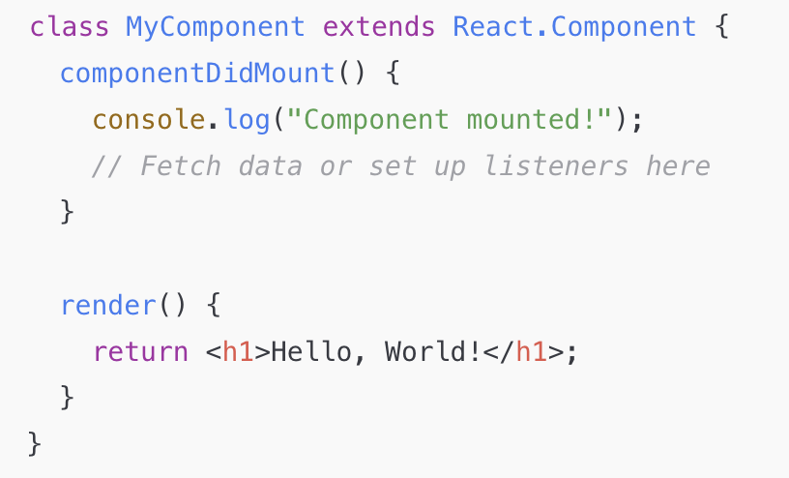
componentDidMount() is a lifecycle method in React class components. It runs once after the component has been inserted into the DOM (mounted). Render() runs every time a state changes.
It is commonly used for: Fetching Data through API

Slide 6
Function Components - Life Cycle
Functional components do not have lifecycle methods like class components (componentDidMount, componentDidUpdate,
etc.).
However, with React Hooks (introduced in React 16.8), functional components can achieve the same lifecycle behavior (using
useEffect hook). Hooks allow function components to have access to state and other React features.
Because of react hooks, class components are generally no longer needed.

Slide 7
UseState Hook
The useState hook in React is used to add state to functional components. It allows you to create and manage local state inside a component without needing a class component.
const [state, setState] = useState(initialValue); //the array returned by useState has been destructured.
state: The current value of the state.
setState: A function to update the state.
initialValue: The initial state value (can be a primitive, object, array, or function).

Slide 8
UseState
useState does not allow partial state updates like setState in class components. When you call setState, it replaces the entire state value instead of merging it in the existing state value.
Correct way to partially update the state:
const [user, setUser] = useState({ name: "Alice", age: 25 });
setUser(prev => { return { ...prev, age: 26 }}); //prev is the previous value of state, i.e., { name: "Alice", age: 25 }
setUser({ age: 26 }); // This will replace the entire state, removing `name`
console.log(user); // { age: 26 } `name` is lost

Slide 9
Problem with useState
It re-render whole component with value is updated
UseEffect to solve this issue

Slide 10
UseEffect
No Dependency Array Runs after every render (initial + re-renders).
useEffect(() => {console.log("Runs on each render"); });
Problem: Can cause performance issues if it runs unnecessarily.
Empty Dependency Array Runs only once, after the first render (like componentDidMount).
useEffect(() => {console.log("Runs only on mount!"); }, []);
Specific Dependencies - Runs only when the specified dependency changes.
useEffect(() => { console.log(`Count changed to: ${count}`); }, [count]); // Runs only when `count` changes, count is a state

Slide 11
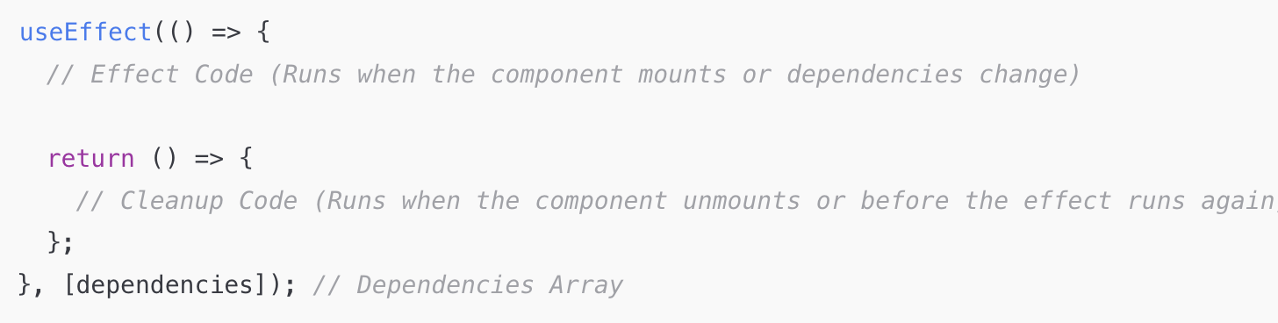
Clear Function in UseEffect
Runs when the component unmounts (removes from page or another component is called)
Prevent memory leaks
Avoid unnecessary event listeners or intervals
Ensure performance optimization

Slide 12
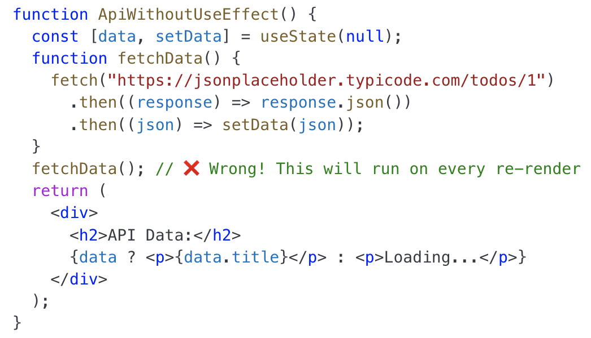
Fetching Data without useEffect

Slide 13
Problem?
Fetch Runs on Every Render
Every time the component renders, fetchData() is called again.
This causes multiple API calls, making the app inefficient.
Infinite Loop Risk
If setData updates state, React will re-render the component.
The function runs again during re-render, leading to an infinite loop

Slide 14
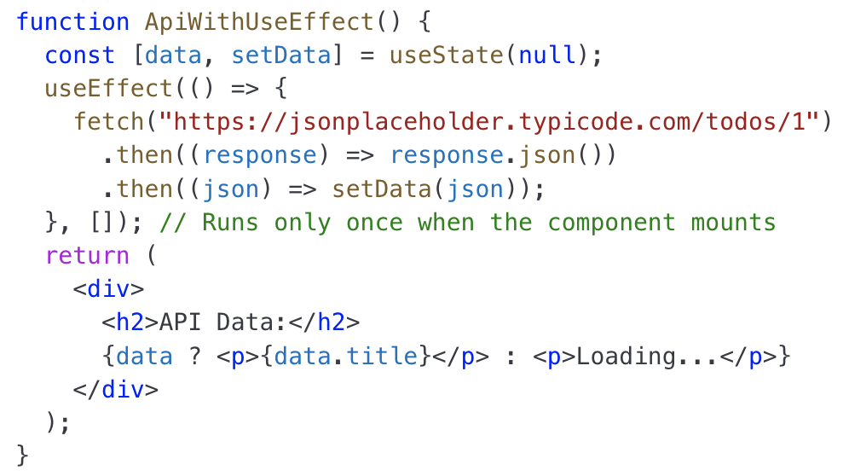
Fetching Data from API

Slide 15
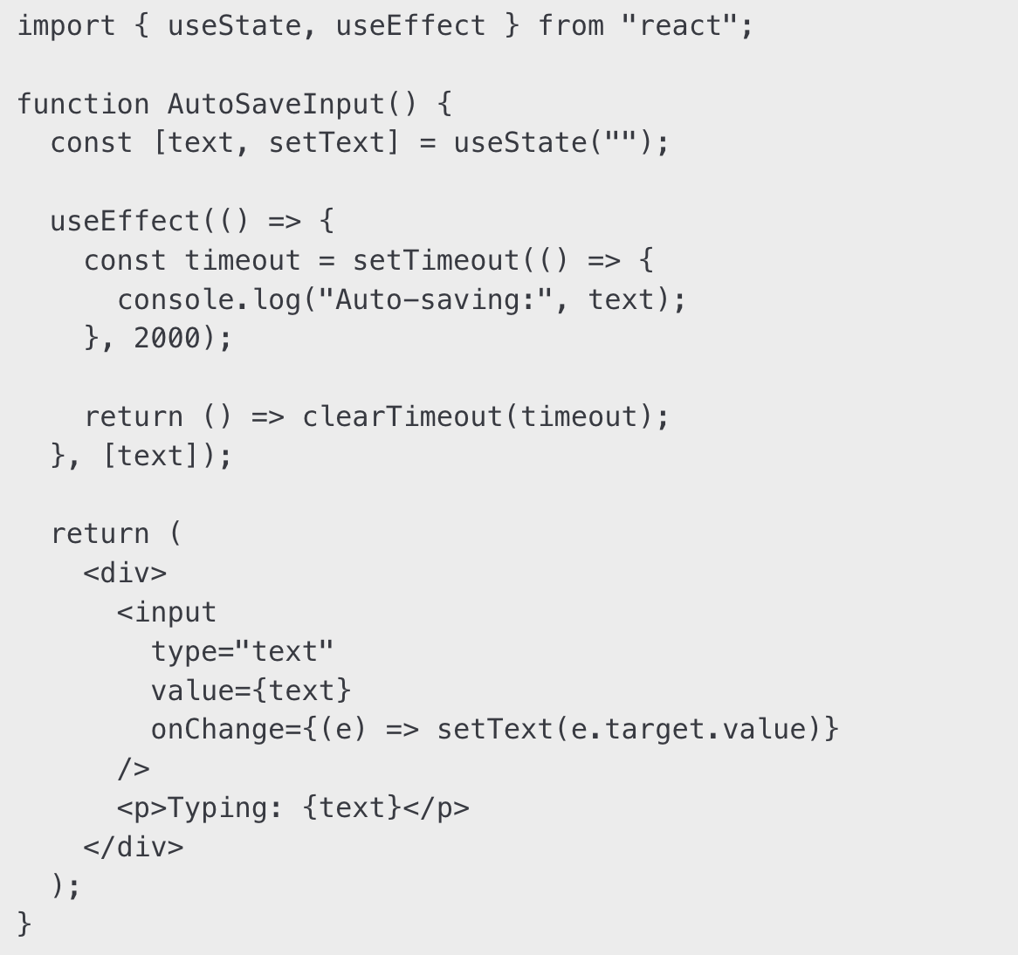
Auto-saving Input fields

Slide 16
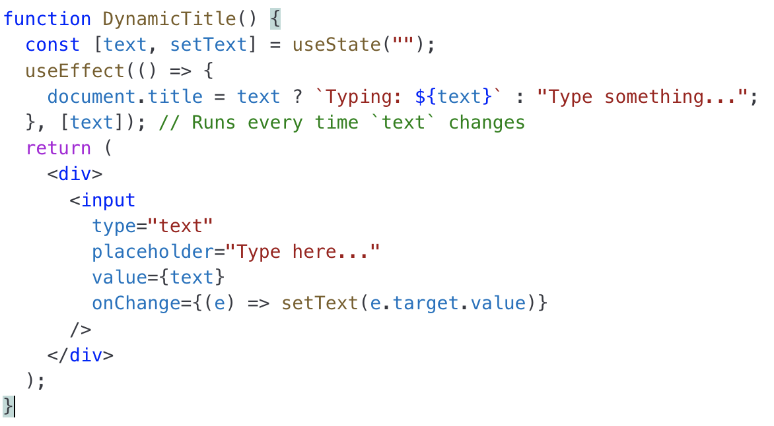
Dynamic Title
It detects state changes (title updates).
It performs a side effect (updating the document title).
Without useEffect, we couldn’t automatically update the page title based on the input value.

Slide 17
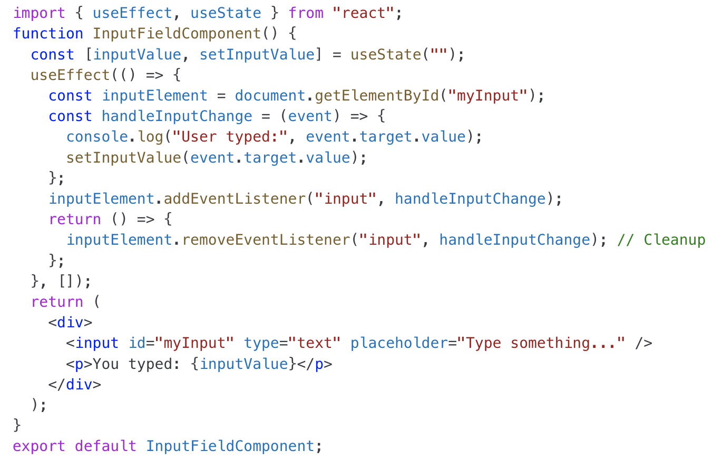
Clean-up

Slide 18
useRef
useRef is a variable that stays the same even when the page updates (re-renders). Unlike useState, updating useRef does not trigger a re-render, but you can still display its value on the page if you want.
Unlike useState, changing useRef does NOT cause a re-render.
Accessing & Manipulating DOM Elements
Storing Previous State Values
Avoiding Re-renders for Unnecessary State Updates
Persisting Values Across Renders

Slide 19
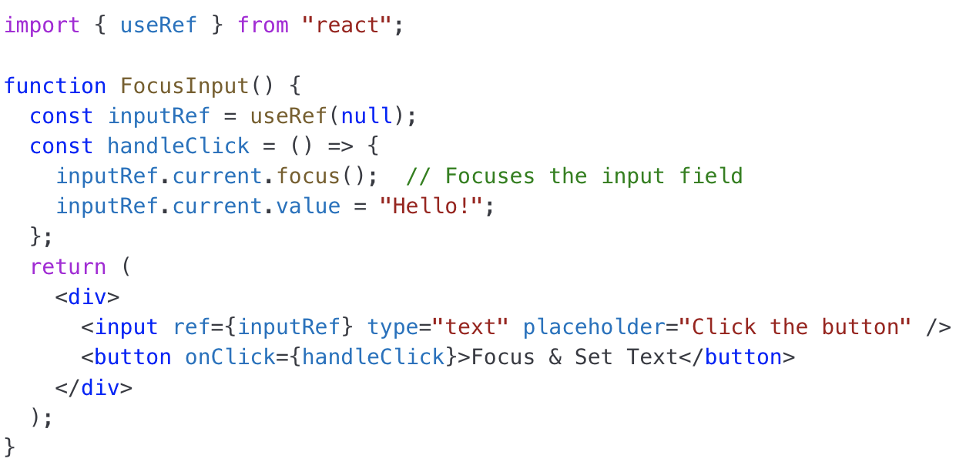
Accessing Dom Elements

Slide 20
Accessing Dom Elements
inputRef.current.style.backgroundColor = "yellow";
inputRef.current.style.color = "red";
inputRef.current.style.border = "2px solid blue";
alert(`Input value: ${inputRef.current.value}`);
inputRef.current.className = "highlight"; // Apply new class

Slide 21
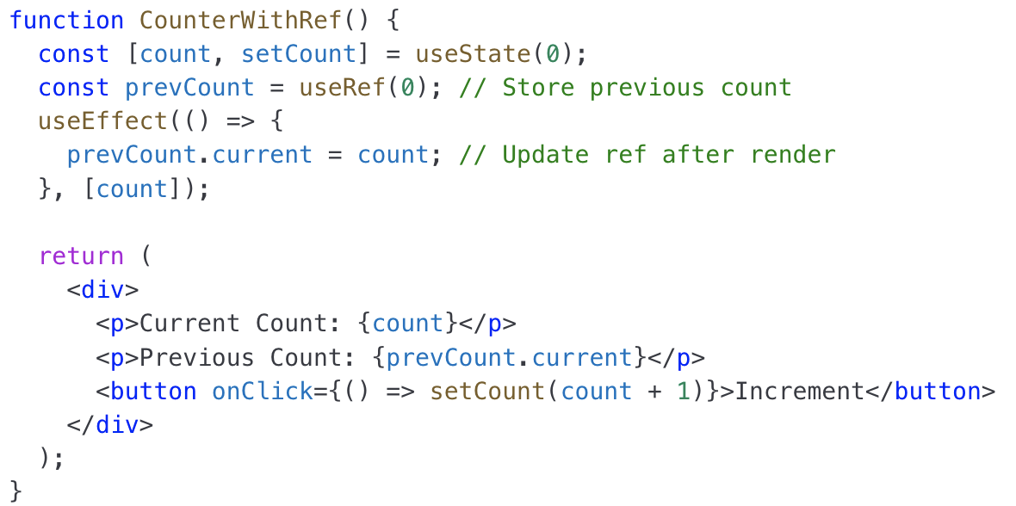
Storing PrevState

Slide 22
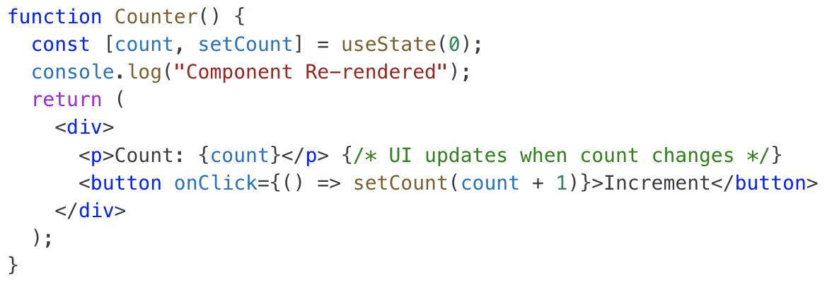
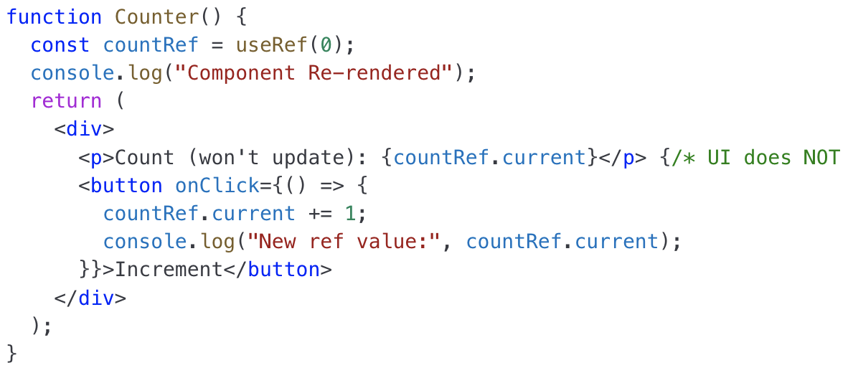

Slide 23
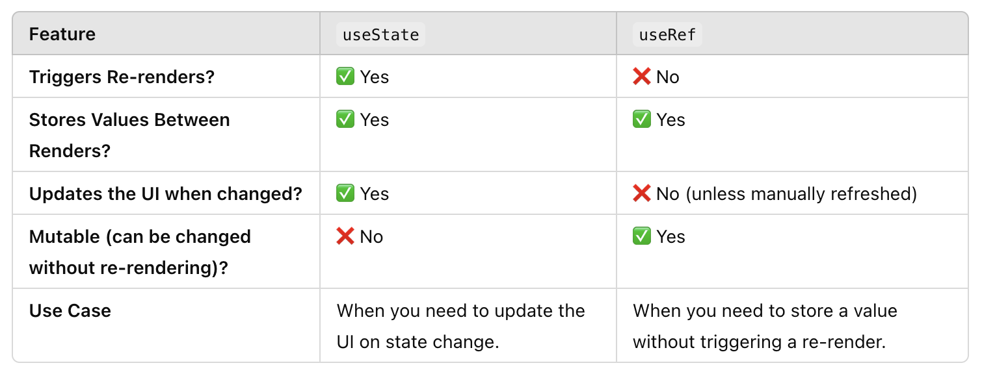
useRef

Slide 24
useRef
Clicking the button updates countRef.current, but the UI does not change.
The component does not re-render.
The updated value is only visible in the console.

Slide 25
useState vs useRef
useSate when you want to re render the whole component on update of a variable or a field
useRef if you want to update the variable or a field but don’t want to re-render the whole component
Example code attached

